Slide 1


Optimizing Airbnb: Strategies for High Reviews in a Dynamic Market
Team 2
Jacob Semmel
Sumit Pal
Srinivas Minnakanti
Mingzhe Chaung
Jathin Reddy Kancham
Nishitha Santhakumar

Slide 2

Introduction & Objective
NYC's Competitive Landscape: As one of the world's most vibrant cities, NYC presents fierce competition among Airbnb hosts, necessitating optimized listings to stand out.
Study Objective: To analyze factors influencing Airbnb listing prices in NYC, including location, room type, amenities, and reviews.
Importance of Understanding: Crucial for hosts aiming to maximize occupancy rates and revenues while enhancing guest experiences.
Data-Driven Insights: Utilizes the Inside Airbnb New York City dataset to explore detailed pricing patterns and provide strategic insights for hosts.
Goal of Enhancements: Aims to help hosts refine their offerings and pricing strategies to boost their competitiveness in a bustling market.

Slide 3
Literature Review
Pricing Impact on Hospitality: Investigates how Airbnb has influenced traditional hospitality and the sharing economy.
Geographic Pricing Influence: Properties in central urban areas like Manhattan and Brooklyn command higher prices.
Property Types and Pricing: Entire homes/apartments are priced higher, reflecting the value of privacy.
Role of Amenities and Quality: Listings with professional photography and detailed descriptions achieve higher prices.
Importance of Reviews: Higher ratings and numerous reviews enable hosts to increase prices.
Dynamic Pricing Strategies: Demonstrates fluctuating prices based on demand, akin to hotel industry practices.

Slide 4
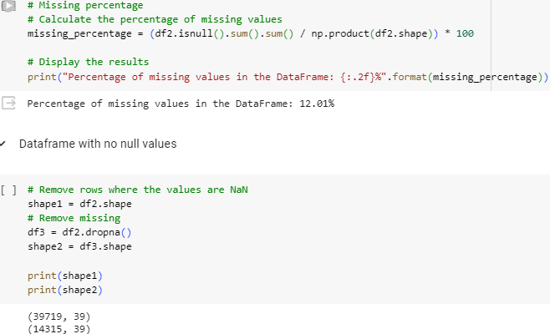
Data Description
Dataset Composition: Analyzes 39,719 entries with comprehensive attributes from property types to host details.
Complexity and Issues: Initial data exploration revealed complexity with varied data types and significant missing values.
Data Source: Kaggle
Data Size: 75 columns and ~40,000 rows
After initial exploration we found we had a fair amount of missing data. From there we decided to create a dataframe where all missing values were removed and look at some imputation methods during modeling.

Slide 5
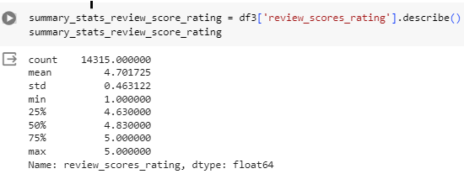
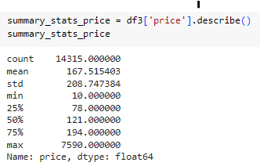
Data Description - Target Variables
-> Stats of our main target variable.
Stats of attempted target variable. <-

Slide 6
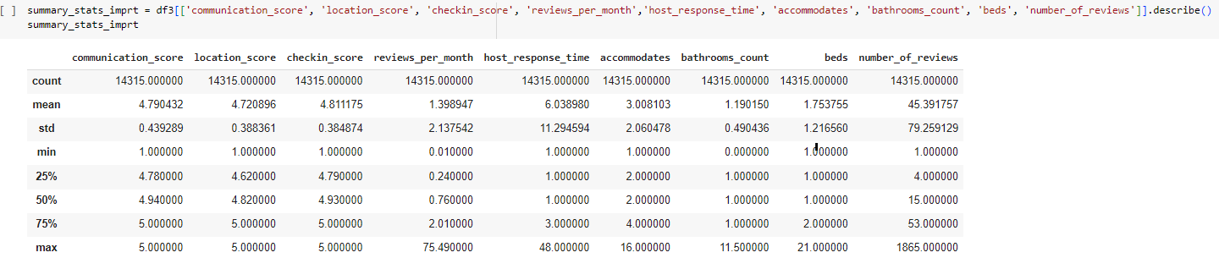
Data Description - Some Input Variables

Slide 7
Data Cleaning
Breaking it down into three steps:
Column Streamlining: Removal of non-essential columns such as URL links, IDs, and highly null fields.
Managing Missing Data: Columns with limited analytical value were removed; used data subset for robust analysis.
Outlier Management: Identified outliers using IQR and Z-score methods.

Slide 8
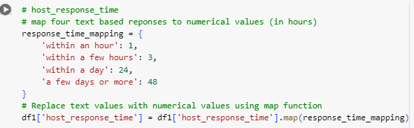
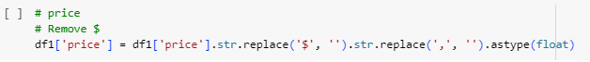
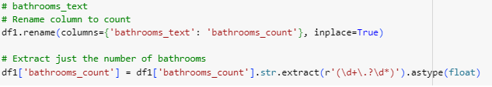
Data Transformation - Methods
Drop columns
Change data types
Mapping
Trimming
Rename columns
Identify missing values
Date/time transformation

Slide 9
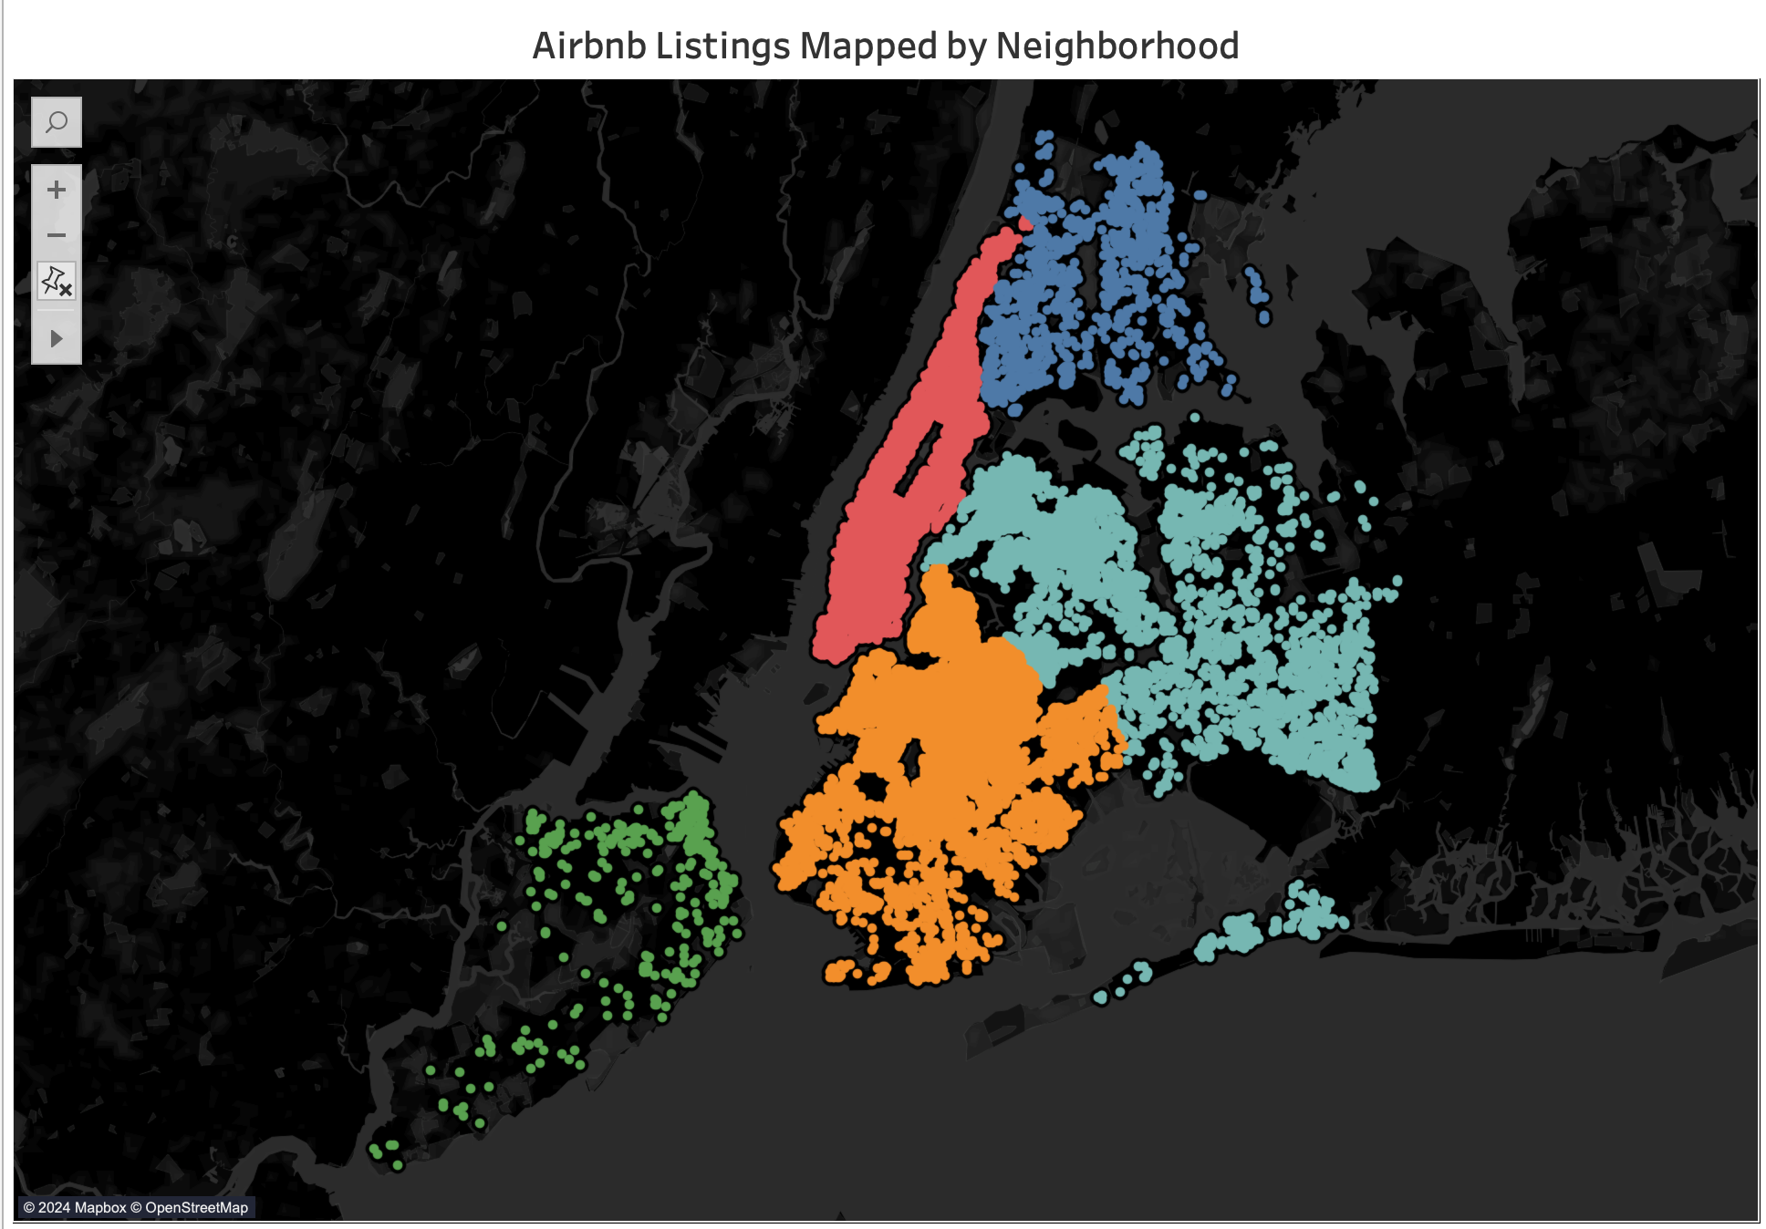
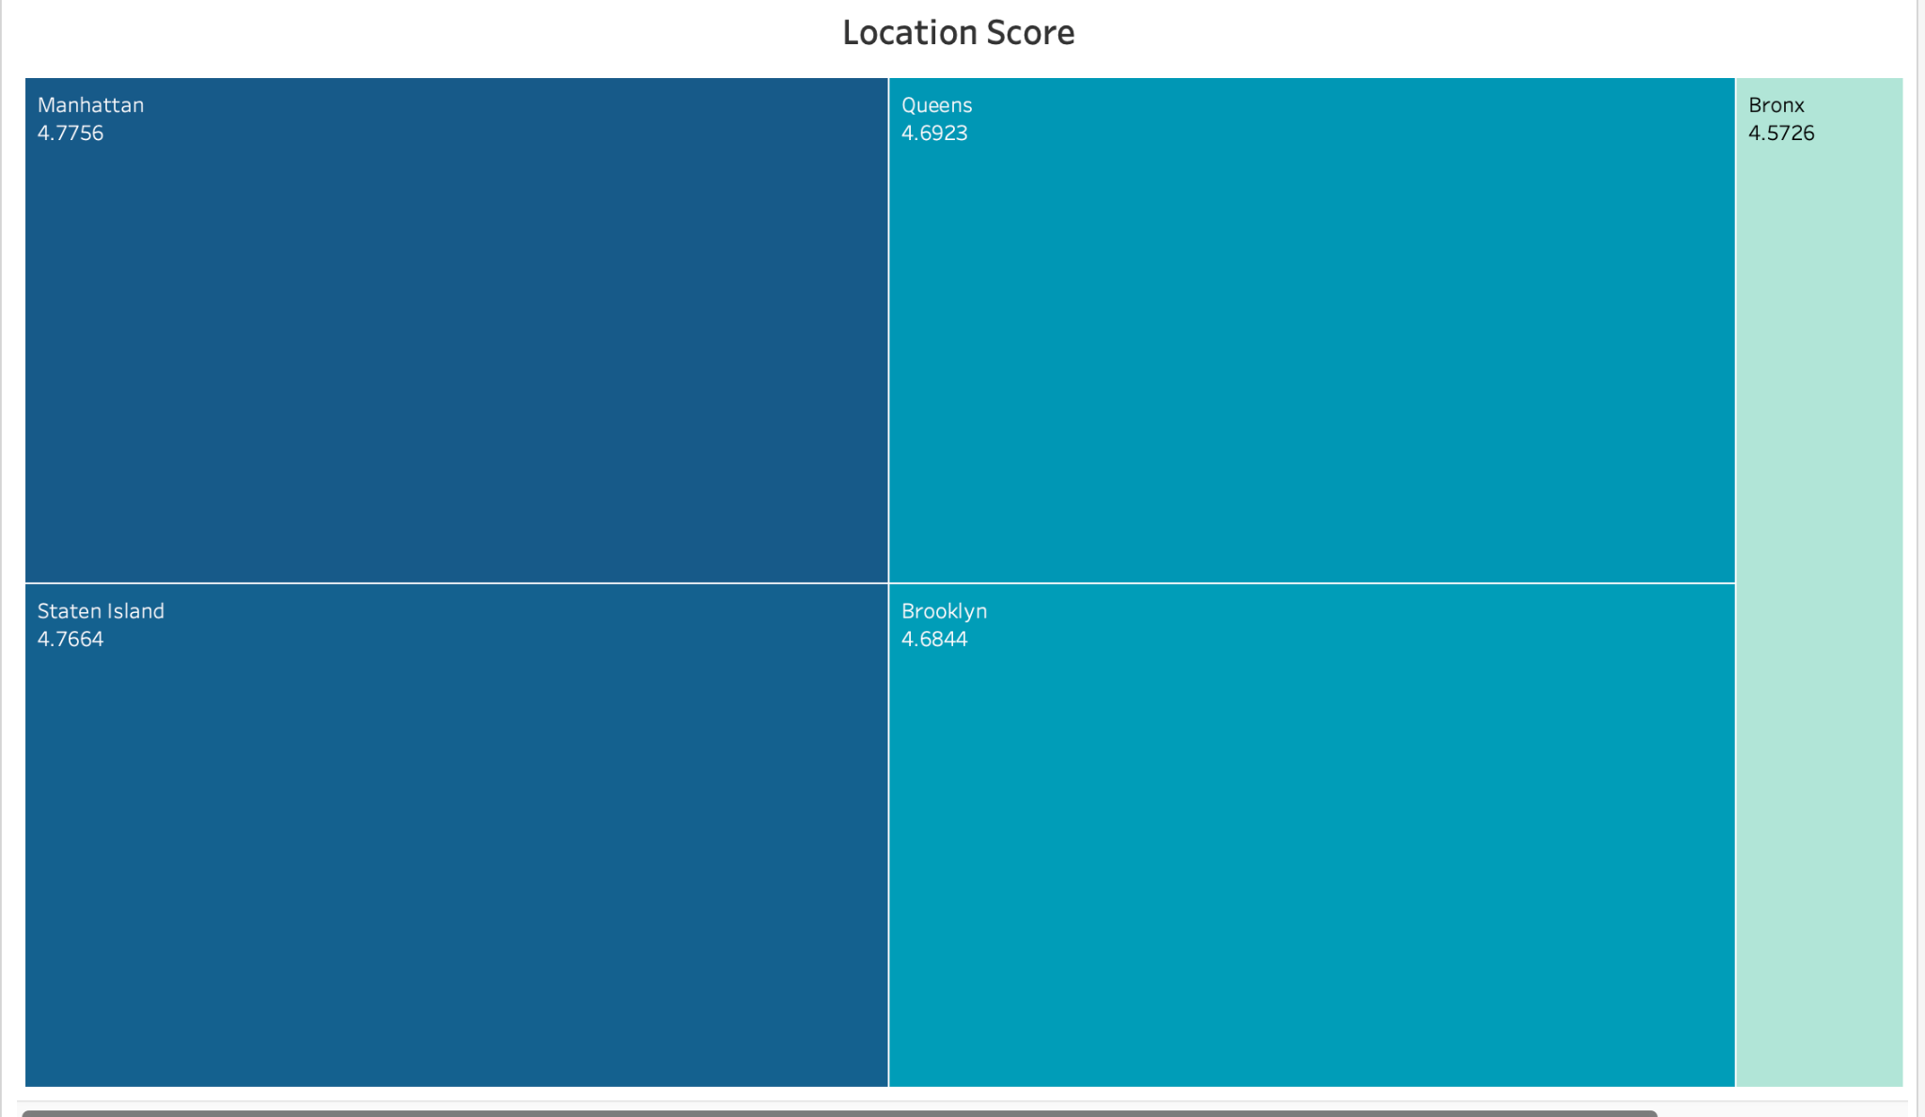
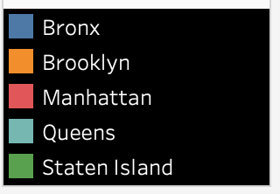
Data Exploration
Demonstrates guest ratings for location convenience across NYC boroughs, with Manhattan leading slightly.
Airbnb listings across NYC neighborhoods.
Helps hosts identify competitive neighborhoods.
Notes:
Geographic Location and Heat map
A significant concentration of listings is visible in Manhattan, indicating a higher demand and popularity.
While hosts cannot alter their geographical location, they have the leverage to adjust pricing. Hosts in prime locations can command premium rates due to high demand, whereas hosts in quieter neighborhoods might attract guests by offering more competitive prices, thus potentially increasing their occupancy rates.

Slide 10
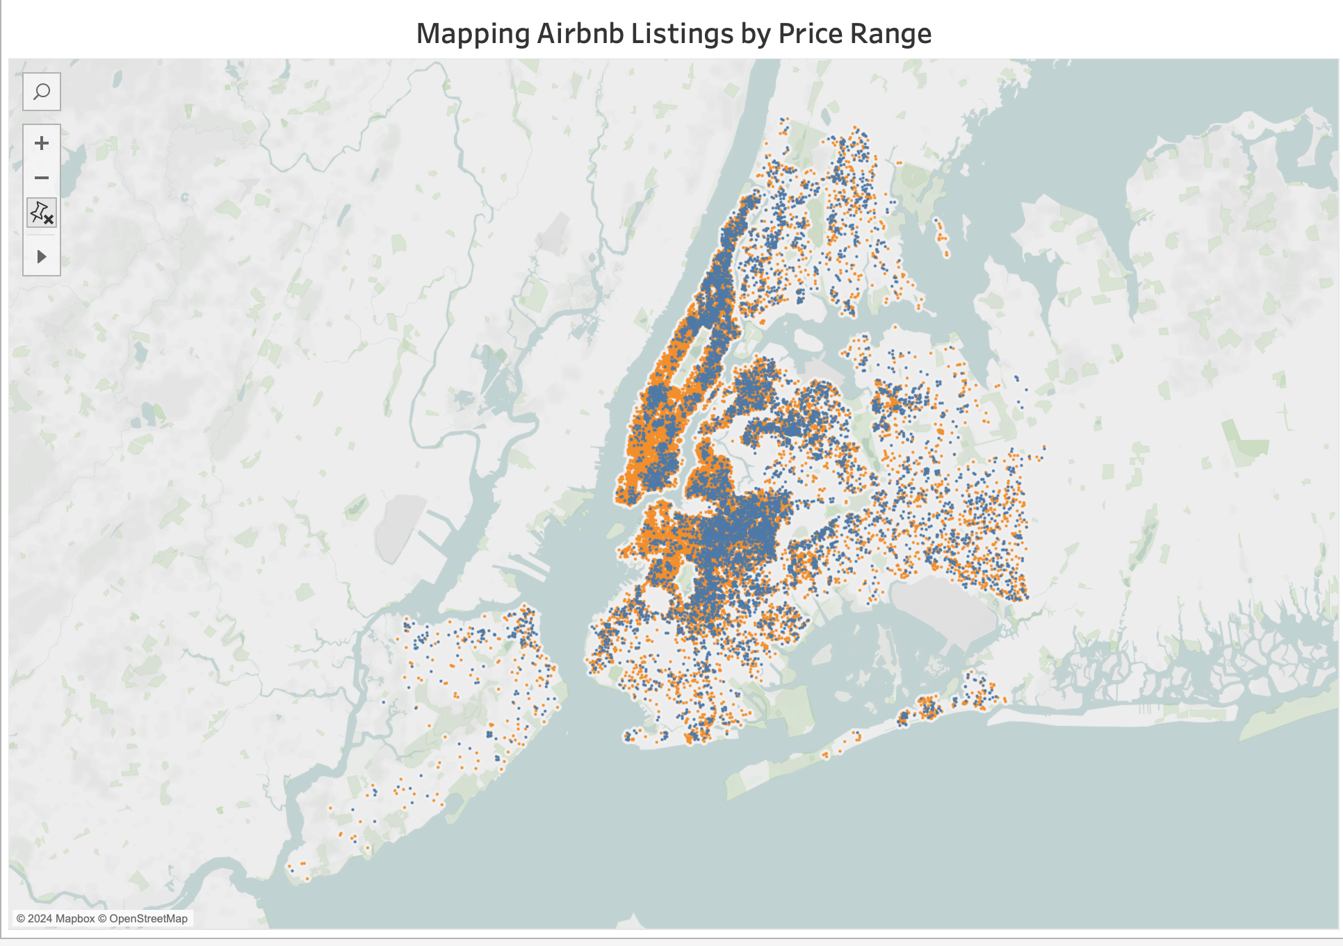
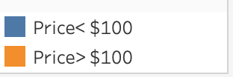
Data Exploration
Illustrates the distribution of Airbnb listings from higher to lower prices across NYC.
Enables hosts to evaluate their pricing relative to market conditions.

Slide 11
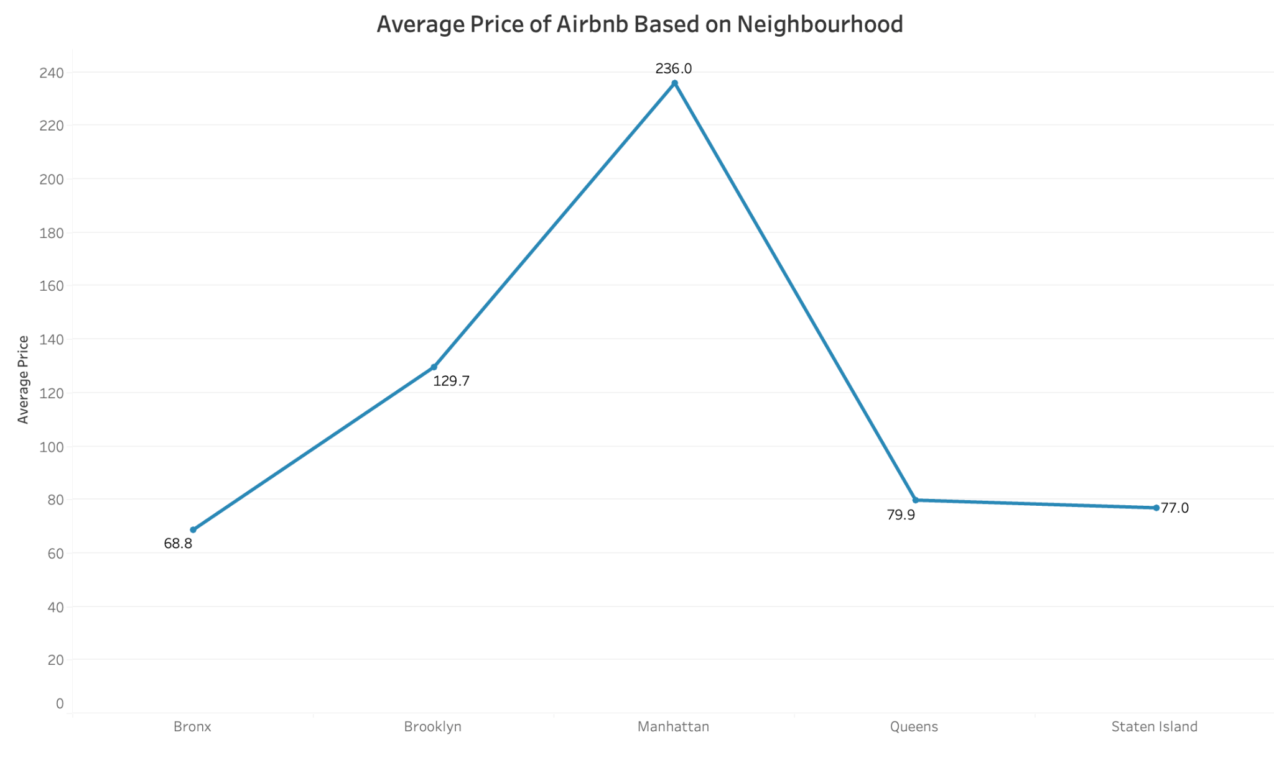
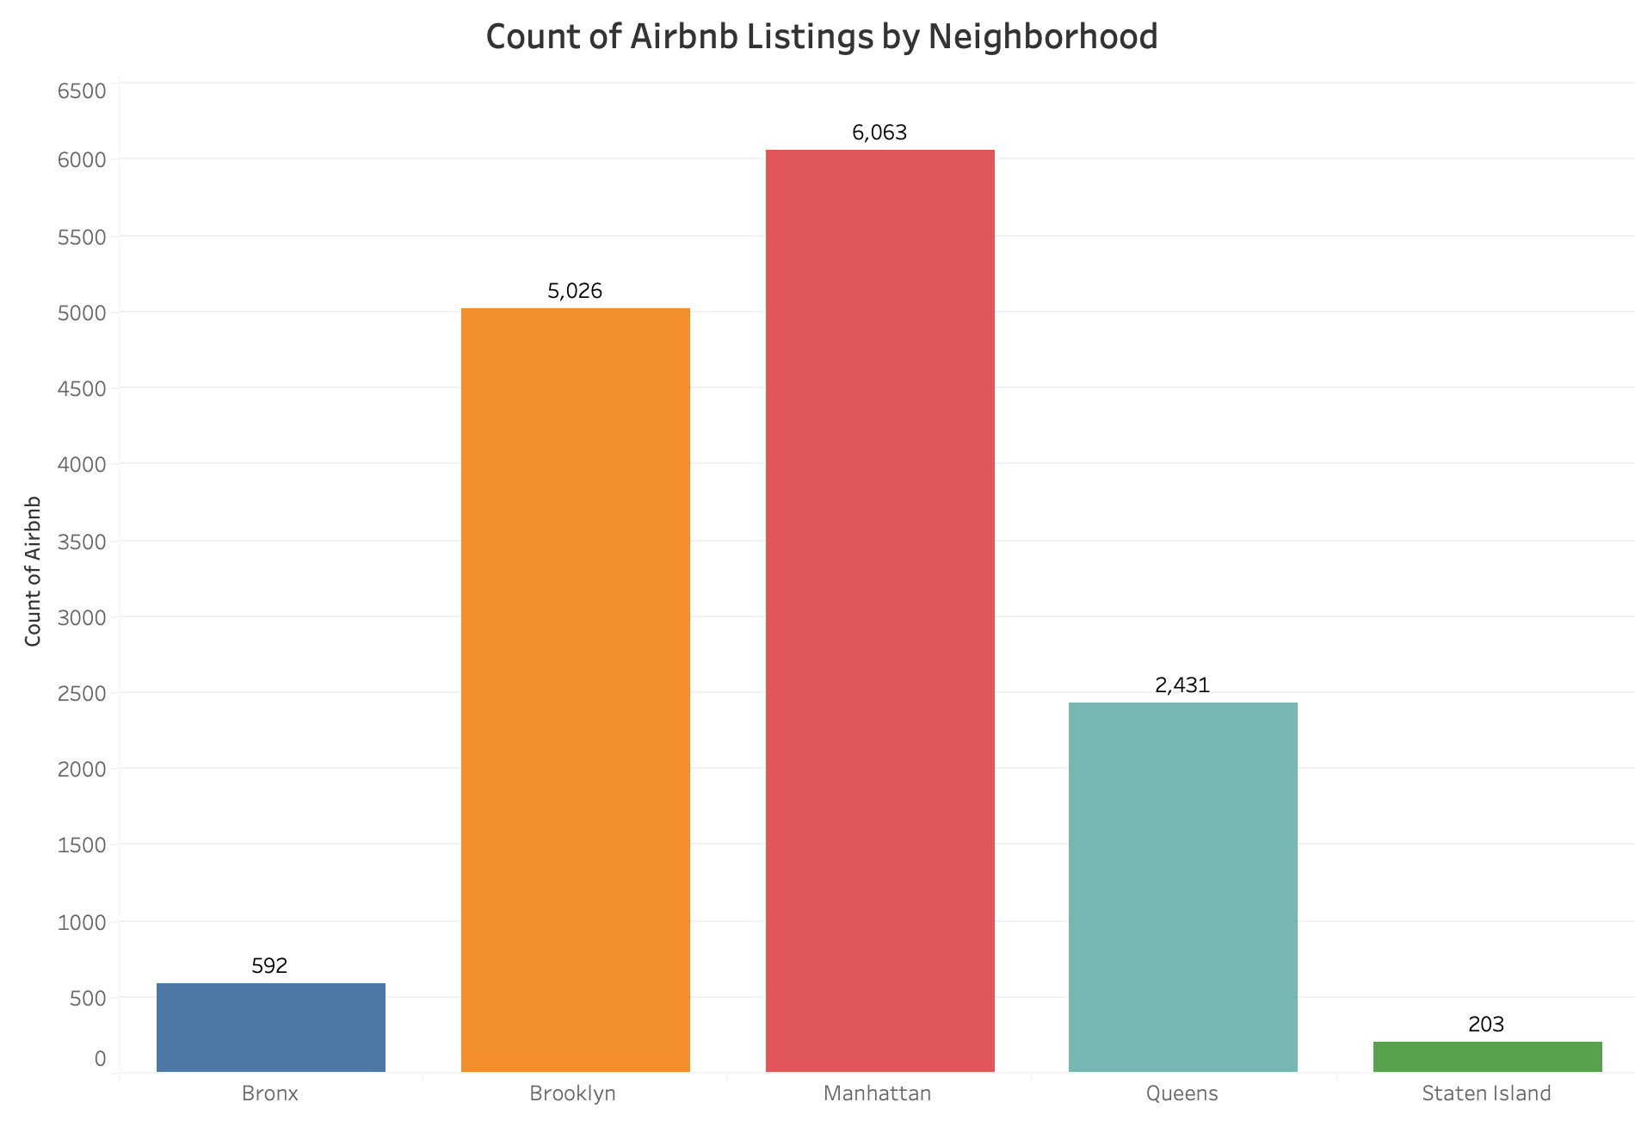
Data Exploration
Line graph shows average listing prices, with Manhattan significantly higher than other boroughs.
Reinforces Manhattan as a premium location due to its higher average prices.
Bar graph shows Manhattan has the highest number of Airbnb listings, followed closely by Brooklyn.
Suggests the need for hosts in these boroughs to differentiate their offerings to stand out in the crowded market.

Slide 12
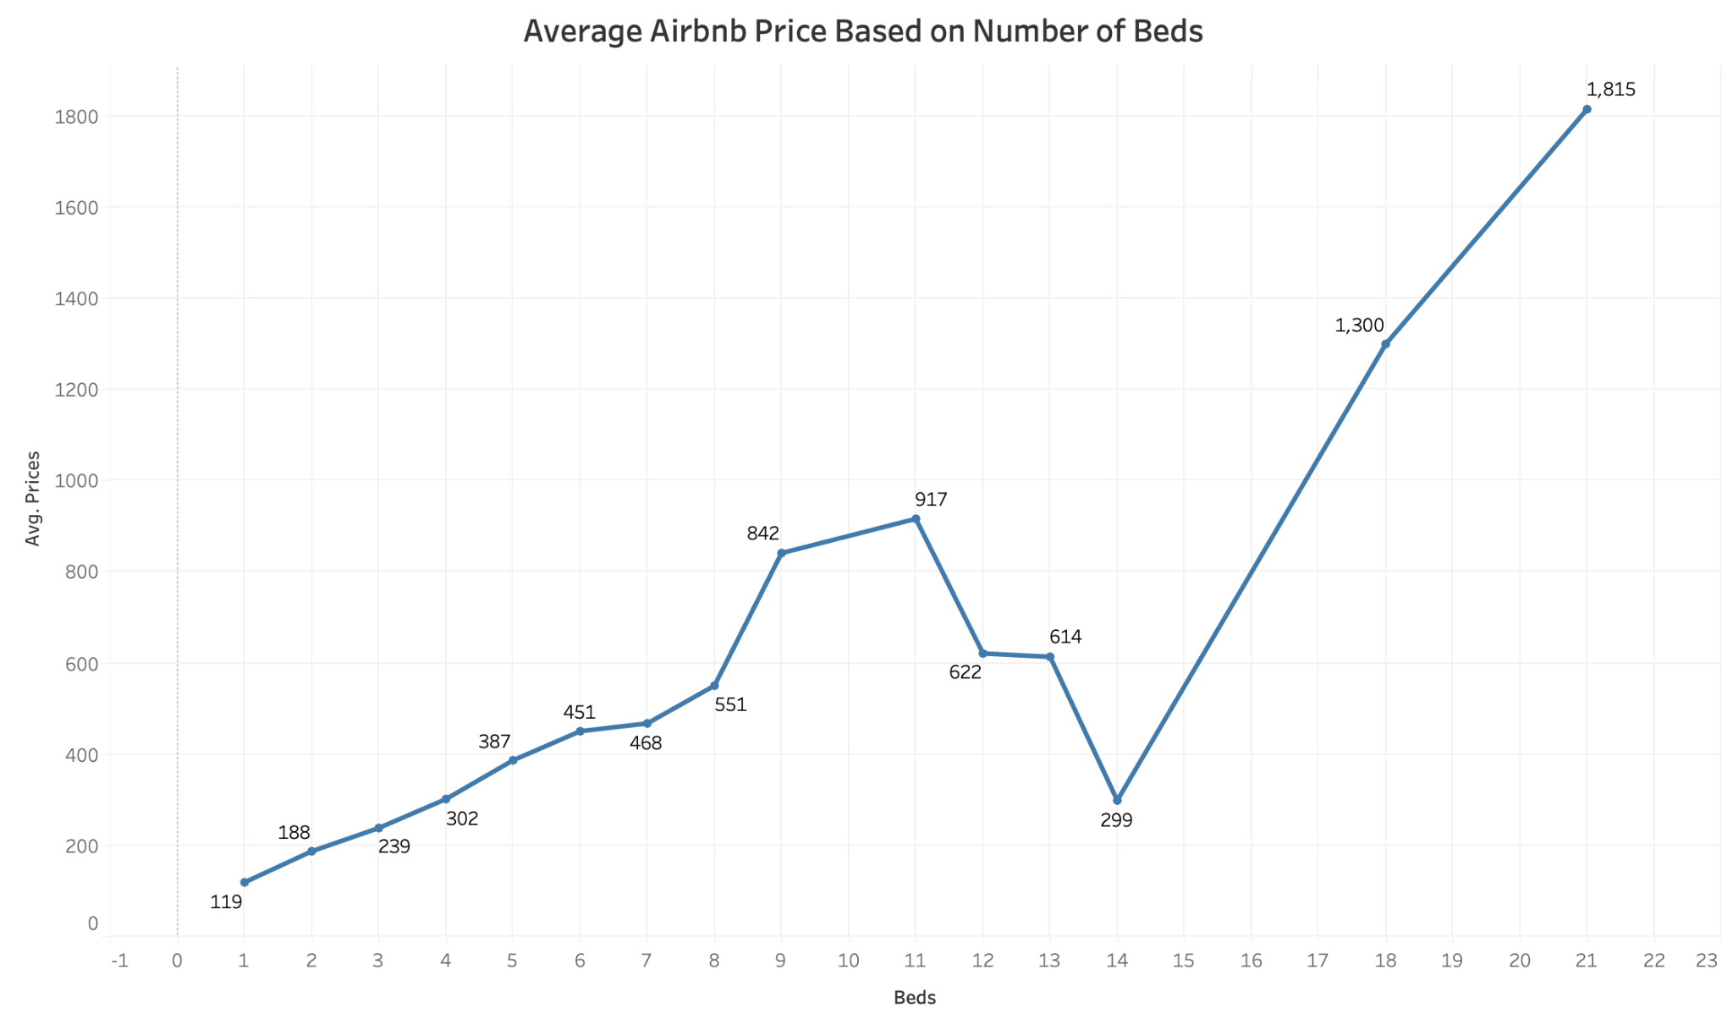
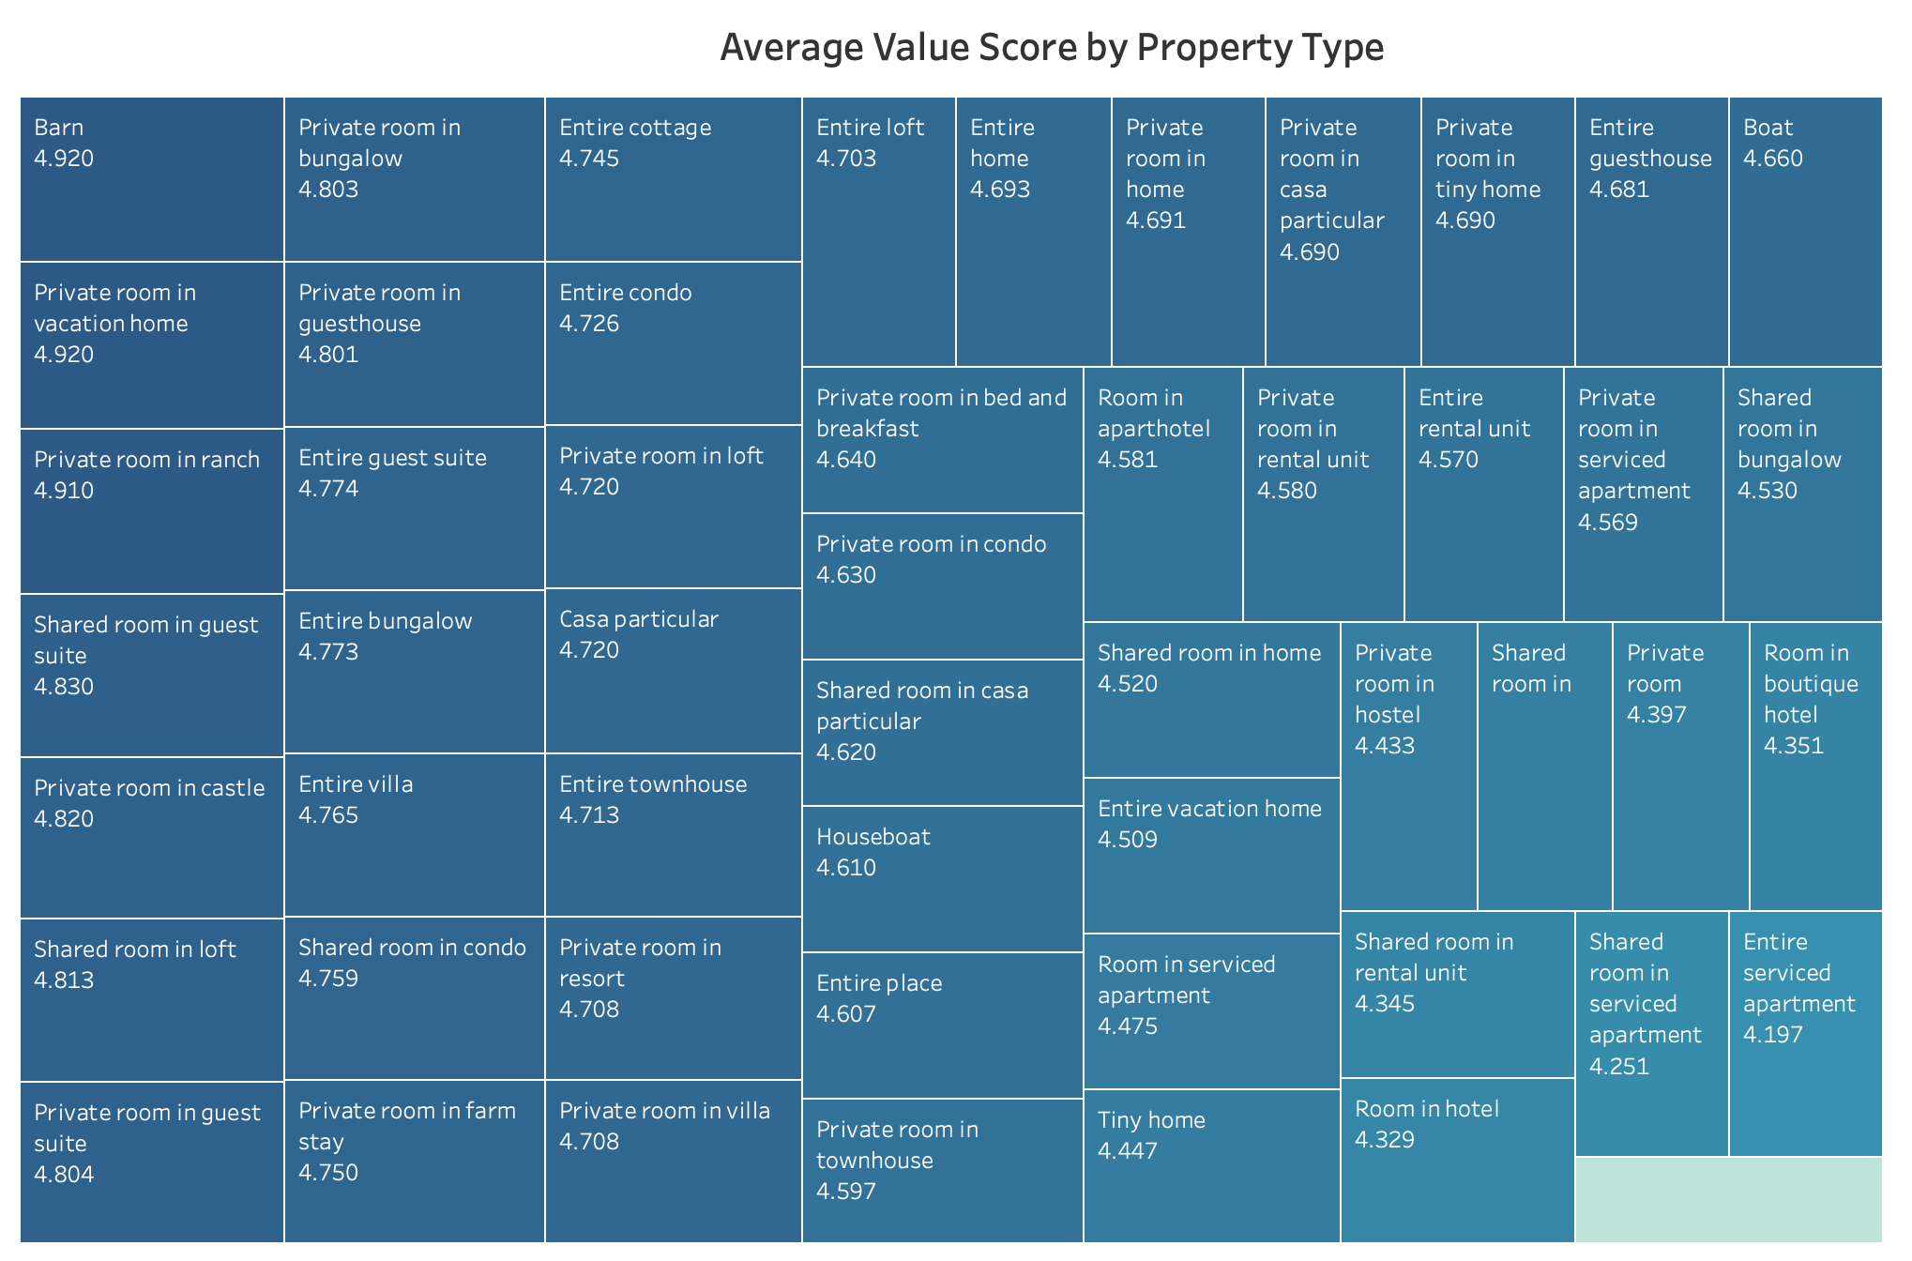
Data Exploration
Pricing Trends: Line chart shows that listings with more beds tend to command higher prices.
Reason for Price Increase: Increased prices likely due to the capability to accommodate more guests.
Strategic Recommendation for Hosts: Suggests hosts can increase earnings by adding more beds where possible, enhancing guest capacity.
Perceived Value Insights: Shows guests rate unique stays like barns and private rooms in uncommon settings highly for value.
Guest Preferences: High ratings suggest a strong guest appreciation for novelty and personal touches of these non-traditional listings.
Host Strategies: Recommends hosts consider enhancing their listings with unique features to boost perceived value and attractiveness.

Slide 13
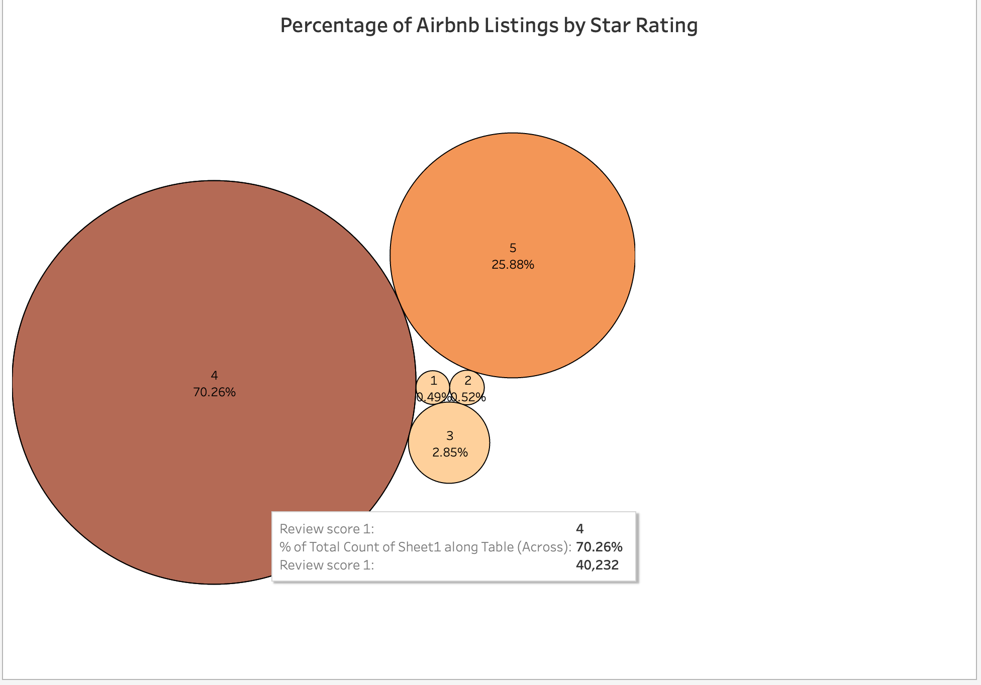
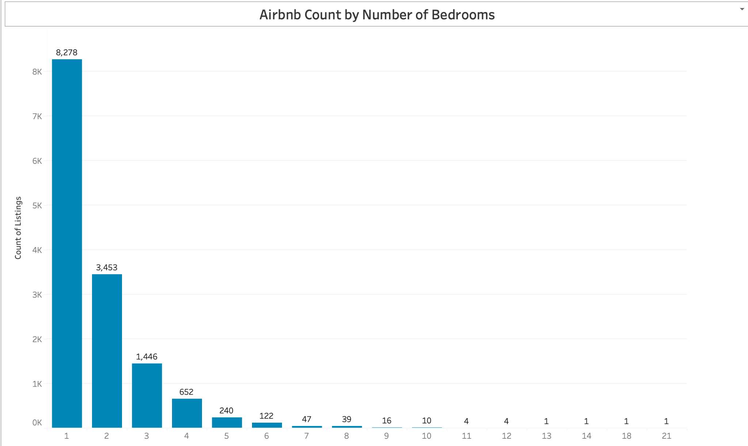
Data Exploration
Rating Overview: Bubble chart illustrates a large proportion of listings have a 4-star rating, fewer have 5 stars, and very few are rated 3 stars or below.
Guest Satisfaction: Indicates that the majority of Airbnb listings are performing well in meeting guest expectations.
Opportunities for Improvement: Highlights potential for hosts to enhance aspects of their service to increase the number of 5-star ratings.
Market Trends: Bar chart reveals a clear dominance of single-bedroom listings, indicating a strong market preference for these types of accommodations.
Demographic Insight: Suggests high demand for single-bedroom listings from solo travelers and couples.
Market Opportunity: Fewer listings with multiple bedrooms point to a potential niche market for larger accommodations suitable for groups or families.
Strategic Consideration for Hosts: Hosts with the capability to offer more bedrooms could tap into this less saturated market, though they should assess the demand carefully.

Slide 14
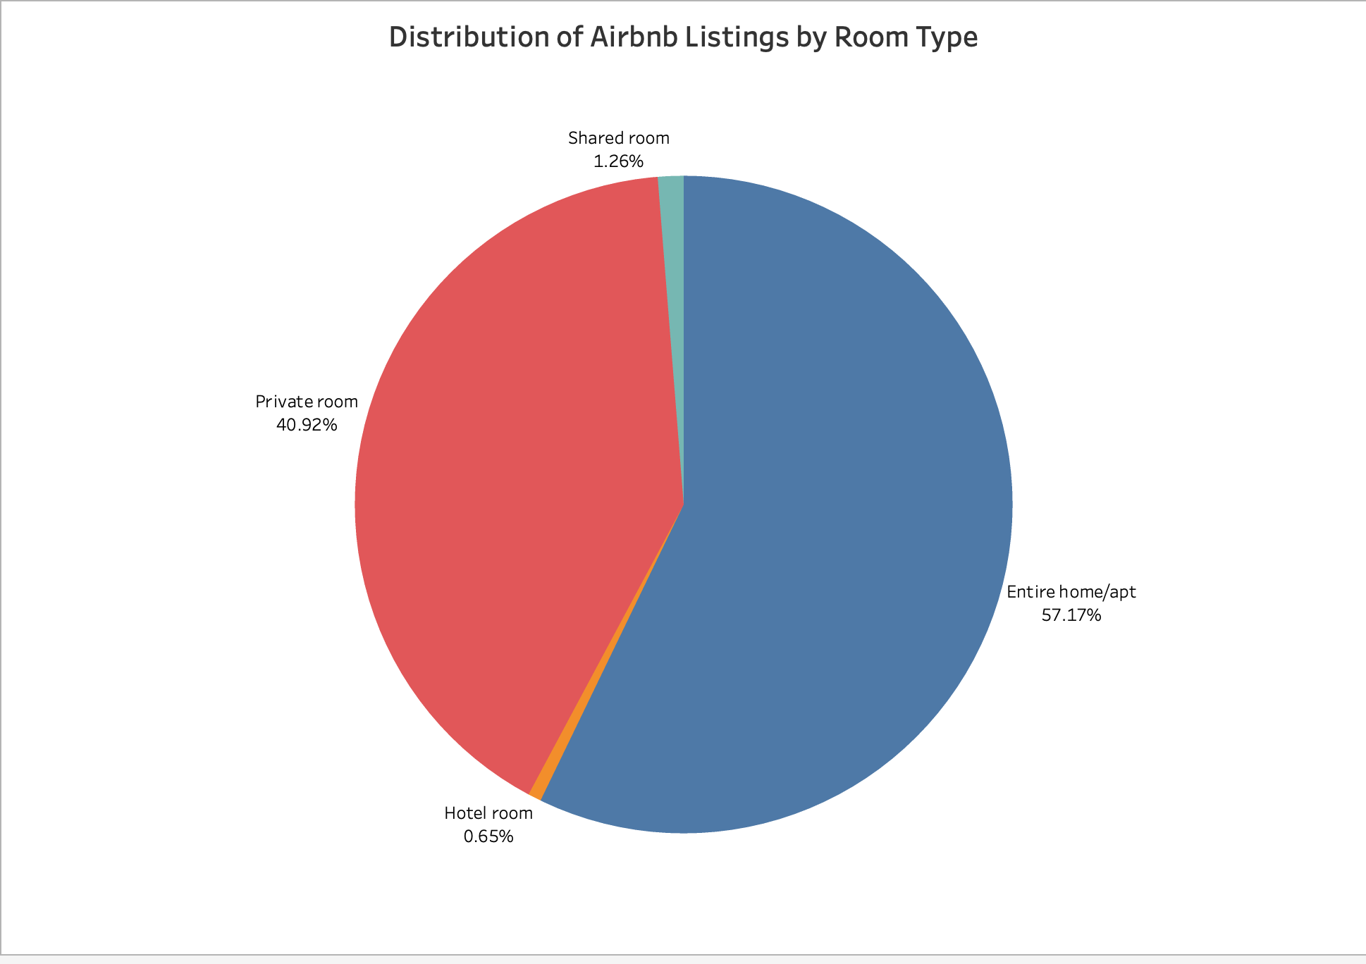
Data Exploration
Listing Preferences: Pie chart shows the majority of Airbnb listings are entire homes/apartments, indicating a strong traveler preference for privacy.
Secondary Market: Private rooms represent a significant portion, appealing to budget-conscious travelers and those in high-demand urban areas.
Minor Categories: A smaller fraction of listings are shared rooms or hotel rooms, catering to niche market needs.
Strategic Implications for Hosts: While offering entire homes/apartments may be more lucrative, providing private rooms can effectively capture a substantial market segment, especially in densely populated locales.

Slide 15
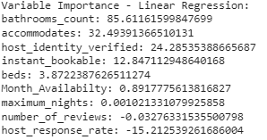
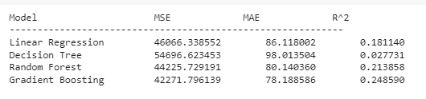
Predictive Modeling- Price
Price as the Target Variable:
Objective: Predict Airbnb listing prices to help hosts optimize pricing strategies.
Data Processing: Removed missing values and selected relevant features impacting price.
Models Used: Linear Regression, Decision Tree, Random Forest, and Gradient Boosting.
Evaluation Metrics: MSE, MAE, and R² to determine model fit.
Results:
Gradient Boosting and Random Forest outperformed other models with the lowest MSE and highest R².
Significant features influencing price included Accommodates and Bathrooms Count.

Slide 16
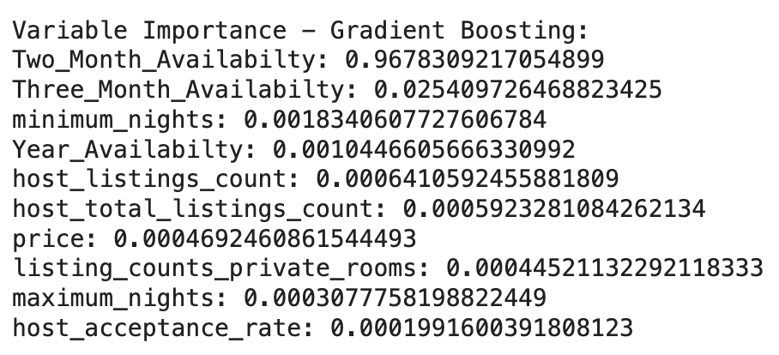
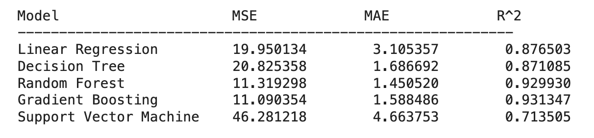
Predictive Modeling - Availability
Availability as the Target Variable: (Month, Two month, and Year)
Objective: Predict availability to enhance listing visibility and maximize booking potential on Airbnb.
Data Processing: Removed missing values and selected relevant features impacting Availability.
Models Used: Linear Regression, Decision Tree, Random Forest, Gradient Boosting, and SVM.
Evaluation Metrics: MSE, MAE, and R² to determine model fit.
Results:
Gradient Boosting and Random Forest better with the lowest MSE, MAE, and highest R².
Important features for Month availability included Min Nights and Price.
Final Insights: More Number of Nights available and Price leads to increase in booking.

Slide 17
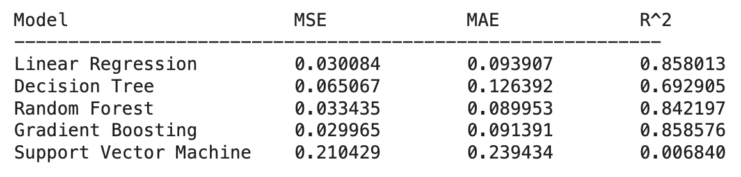
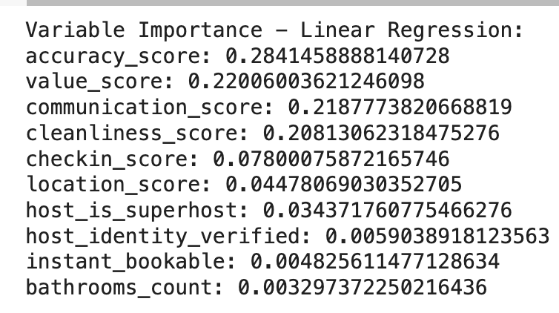
Predictive Modeling - Review Rating
Review Score Rating as the Target Variable:
Objective: Understand factors that predict guest satisfaction using Airbnb review scores.
Data Preparation: Focus on features like host responsiveness, property specifics, and operational metrics.
Models Employed: Linear Regression, Decision Tree, Random Forest, Gradient Boosting, and SVM.
Training & Testing Split: 80/20 with the training set containing 11,452 entries and the test set containing 2,863 entries.
Model Evaluation: Metrics included MSE, MAE, and R² scores.
Results:
Linear Regression and Gradient Boosting performed best with the lowest MSE and MAE.
Key predictors were Communication Score, Check-in Score, and Location Score.
Standardization & Normalization: Techniques were applied to normalize data for model training.
Residual Analysis: No evident patterns, suggesting models were well-fitted.
Conclusions: Analysis highlights the importance of communication and location in enhancing guest experience.

Slide 18
Findings
Geographic Location: Central locations like Manhattan achieve higher prices—emphasizing the real estate principle of "location, location, location."
Number of Bedrooms: Direct correlation between the number of bedrooms and price, underscoring the value of space.
Amenities: Well-equipped listings command premium rates, reflecting guest preferences for comfort and convenience.
Host Reputation: Higher ratings in cleanliness and communication enable hosts to price higher, highlighting service quality importance.
Modeling Insights:
Dynamic Market Response: Listings adjust prices in response to demand changes due to seasonal variations and local events.
Market Saturation Effects: High concentration of one-bedroom apartments leads to competitive pricing, necessitating differentiation in the market.

Slide 19
Stakeholder Responses
What do our stakeholders report?
Q: What drives interest in booking your airbnb?
A: The exclusive location.
Q: What factors about your airbnb makes it attractive to the market?
A: Location, fairly priced, quality amenities, great review.
Q: Are there common themes or recurring issues in the negative feedback you've received from guests?
A: The only negative feedback is the fees and the occasional pool issues that are out of our control.
Q: Are there ways you could improve your communication to better meet guests' needs and expectations?
A: We respond within 10 mins to any email from a guest. The issues with the pool are out of our control, however, we respond immediately that we have no control over pool access and temperature.

Slide 20
Recommendations for Business
Recommended Strategies and Enhancements for Airbnb Hosts
Regularly compare prices with similar listings to maintain competitive edge.
Offer tiered pricing for extended stays to attract new guests and boost occupancy rates.
Encourage guests to leave reviews by providing excellent service, personalized touches, and maybe a small incentive for reviewing.
From our Review Rating model we see communication plays a crucial role in so hosts should actively manage and respond to reviews, addressing any negative feedback to improve future guest experiences.
From variable importance of Review Rating model the location is a significant factor, highlight proximity to key attractions, easy transport links, and the availability of nearby amenities in the listing description.
Stay informed about local events and holidays to anticipate increased demand and adjust offerings and pricing accordingly.
Enhancing Listing Attractiveness
Investment in Amenities: Upgrade listings with high-quality amenities to justify higher pricing.
Accuracy in Representation: Ensure that all listings are accurately described and photographed to improve guest satisfaction.
Visual Appeal: Use professional photography to significantly enhance the visual appeal of listings.
Personalized Guest Experience: Create unique, tailored experiences for guests to encourage higher ratings and repeat visits.

Slide 21
Thank You!

Slide 22
Questions?

